Slide 1

RxClaim Delivery Review Jan ‘18

Slide 2
Agenda
Agenda
Executive Summary
Current Head Count & Demand
Capacity Utilization & Forecast
Attrition Trend
Delivery Highlights & Updates
Initiatives – BI/CI
Our People First
2018 Focus Areas

Slide 3
Executive Summary - 2017
Insource IP related work & Growth
Successful Transition of ~ 100 vendor resources from IBM, CTS & GalaxE primarily in RxClaim Core Product Development - Total Team size of 200+
8.3.06, 8.3.07 & 8.3.08 deployed successfully with ~ 50% accountability of development - 8.4.0 are in progress – 300 + SRs worth >60 K hrs of Development work
5 MODS releases for LORx with more than 600 SR’s & more than 20 K hrs of work
~ 40 Custom Capital Projects worth more than 20 K hrs
Custom Deli (Eligibility & Work Order) - 26 projects, 130 Work Orders with more than 20 K hrs
Support team closed more than 3000 service now tickets & 130 problem tickets and also contributed around 1K hrs of Dev efforts towards PLM upgrade projects for Vitria and the RXMACRO application to enhance stability & security
Delivery Execution
Cost
Achieved a business impact of $5.18 Mn vs. a target of $ 4.27 Mn (exceeded by 20%)
Business Impact
Automation of Manual Claim Entry Solution presented to Business stakeholders
Solutions provided for 8 ideas to improve process efficiency in collaboration with BPO team
Business Process improvement through IT/BPO collaboration
AS400 Competency
Designed & created a framework for trainings & onboarding . Concluded 2 batches of TDP academy
Certification program designed for L1 & L2 assessment
Vital Sign – 80%; 300+ Bravos for 120+ team members from 60+ US leaders (IT / Business)
Delivery Updates

Slide 4
Current Headcount and Demand Forecast / Fulfillment
Current Headcount and Demand Fulfilment
Leader | Lead / Manager | Team | / Approved Headcount | On Board | Jan | Feb | Mar | Apr | Open
Bob Kudis | Tarek | Base Deli (Medicaid + Fast Track) + GUI | 19 | 18 | 1 | 0 | 0 | 0 | 0
Bob Kudis | Raj Velnati | MODS + Retrofit + Kaiser | 26 | 26 | 0 | 0 | 0 | 0 | 0
Bob Kudis | Cindy | CBS + Payments | 23 | 23 | 0 | 0 | 0 | 0 | 0
Bob Kudis | Penny | Govt Program | 25 | 24 | 1 | 0 | 0 | 0 | 0
Bob Kudis | Krishna K | RxClaim SSMO | 31 | 29 | 2 | 0 | 0 | 0 | 0
Bob Kudis | Vishal Prateek | EDI SSMO | 6 | 6 | 0 | 0 | 0 | 0 | 0 | 130
Sameer D | Keith Chan | Plan | 28 | 28 | 0 | 0 | 0 | 0 | 0
Sameer D | Navin | External Interfaces | 7 | 7 | 0 | 0 | 0 | 0 | 0
Sameer D | Rob Planica | EDMI | 2 | 2 | 0 | 0 | 0 | 0 | 0
Sameer D | Kalyana | Eligibility & Work Orders + RxCCR | 16 | 16 | 0 | 0 | 0 | 0 | 0 | 53
Dave Cattran | Scott M | Modernization | 6 | 6 | 0 | 0 | 0 | 0 | 0
Dave Cattran |  | Eligibility Modernization | 5 | 5 | 0 | 0 | 0 | 0 | 0
Dave Cattran | Erika | Rx Support Tech Transformation/Optumizers | 2 | 2 | 0 | 0 | 0 | 0 | 0 | 13
Nitesh |  | RxWeb/RxBuilder SSMO | 12 | 12 | 0 | 0 | 0 | 0 | 0
Nitesh |  | Formulary | 6 | 1 | 0 | 0 | 0 | 0 | 5 | 18
Dan Zerafa |  | RxClaim | 1 | 1 | 0 | 0 | 0 | 0 | 0
Dan Zerafa |  | 2018 Additional Demand | 7 | 0 | 1 | 0 | 4 | 0 | 2
Jim Park | Jim High | Cigna | 1 | 1 | 0 | 0 | 0 | 0 | 0
Christina | Dawn | RxParallel | 3 | 2 | 1 | 0 | 0 | 0 | 0 | 3
Kim Jackson |  | Release / Operational Management | 4 | 1 | 0 | 2 | 0 | 0 | 1 | 4
Bill Meyer | Amie | Ab-Initio | 6 | 6 | 0 | 0 | 0 | 0 | 0 | 6
 |  | Total | 236 | 216 | 6 | 2 | 4 |  | 8
Resourcing Updates
Hiring for 2018 Additional demand for iSeries is in progress - 6 folks aligned to RxClaim Core Support
Requisitions for 6 Formulary positions initiated & in approval process
Notes:
Lets look at the number of CTS resources for Jan, Feb & March…
Jan is showing 6 and we are at end of month – may not be correct

Slide 5
Utilization - Current and Forecast
Utilization – Q4 2017
Q4 2017:
Reasons for High TAFW :
2 days of holiday in Oct, 2017.
Planned leaves due to Diwali Festival
Modernization – Some KT hours due to Resource Movement
Jan’18:
High (15-20%) TAFW anticipated due to New Year holiday and festival vacation plans.
High Admin hours anticipated due to Agile trainings planned for the teams.
No KT or Admin hours expected
Forecasted Utilization - Jan

Slide 6
Attrition Trend for 2017
Highlights
Attrition is low as compare to broader organization & industry Top performers' retention is high – 97%
Next Steps
Notes:
MODS 1, Govt Programs 2, CBS 1, EDI 2, RxParallel 1, Deli 1, RxWeb SSMO 1, RxClaim SSMO 1

Slide 7
delivery updates

Slide 8
Engagement Updates (BASE Releases)
# Releases
3 | 3 | 3 | 1 | 1 | 3 | 5
Key Achievements / Functionalities Delivered
EGWP Phase 1: Introduced new set of EGWP rules to support complex benefits for members at POS in addition to enhancement to the pricing logic for Medicare plans
Enhancements to NCPDP load programs to support additional data related to Pharmacy for government program compliance
Enhanced Transitional Benefits logic to optionally pay drugs only up to a certain quantity as defined by the plan by introducing Daily Dose restrictions
CalPERS Projects: To execute payments and remittance advices to members and pharmacies in support of the implementation of CalPERS. There are custom files and reports that require development using file layouts supplied by both entities.
Cigna Projects: Updated the PA reporting/loading processes to extract/load the PAs multiple times during a day as needed by the Clients. Allow clients to load/extract additional data to the Pharmacy Cost Pricing Schedule using which the Plan finder files are generated.
Other major Projects: Texas ERS Surcharge Reporting Project: To enhance RxClaim to calculate surcharge values based on client rules, record and report the same for payment and billing.

Slide 9
BASE Releases Metrics
Note : Increase in the Development defect density for Plan 8.3.07 is due to the increased Scope, Complexity and Frequent FRD/GUI changes. Approx. 42% of QA defects were due to missing requirement in FRD.
In order to improve the delivery quality, we have adapted the SDR process, strengthen the peer/lead reviews and work through the teams using internal defect review forum.

Slide 10
Engagement Updates (Monthly Releases)
# Releases
9 | 12 | 12 | 3 | 12
Key Achievements / Functionalities Delivered
Implemented one of the big 3 clients “CalPERS” into RxClaim
Implemented new enhancements for CA, AZ, IL state Medicaid and mitigated the potential penalties of $120k
Performance tuning of CalPERS claim extract to run from 8 days to 5 hours is a big improvement
MAC pricing automated generation for Washington client completed and implemented successfully
Migrated OHIO and OPTIMA clients from SXCA6 production box to BK1 prod system. File generated and sent to client on 1/2 without any issues
POLARIS program - modifications of Eligibility and Claim History files and deployed in BK2 on 12/1
TEXAS ERS - Moved the membership from Book2 to Book1 and also involved for complex WTX map, ID card extract and Claim History file related changes.
WTX - Implemented new maps for Hartford, Morgan Stanley and Federal reserve bank with aggressive timelines
NICE - Project to add new accounts to the existing eligibility load on Book1

Slide 11
Monthly Releases Metrics - 2017
Note : Increase in the defect density for Work Order team was in the month of July where team finished the transition and took over independently. There were also change in requirements for which team was not completely equipped.
In order to improve the delivery quality, we did the RCA of defects and improved the delivery using specific actions like regression testing , etc.

Slide 12
Engagement Updates (Sprint Releases)
Key Achievements / Functionalities Delivered
State Medicaid team is the first team in RxClaim to adapt Agile methodology development. A journey of successful implementation of 4 sprints covering 253 user points without any business defects in production proved the sustaining adaptability of the team
As part of Product Increment1 (2017-PI01) , deployed following with no issues
VA – 5 corresponding SRs deployed to Production
HNJ – 3 corresponding SRs deployed to Production
OR - 2 corresponding SRs deployed
Successfully submitted Utah encounter Test file with state. Acceptance ratio of claim is ~98.7%.
Virginia Encounter implemented successfully in a short time and received a positive acknowledgment from state.
Optumizers successfully completed of 4 sprints without any issues.

Slide 13
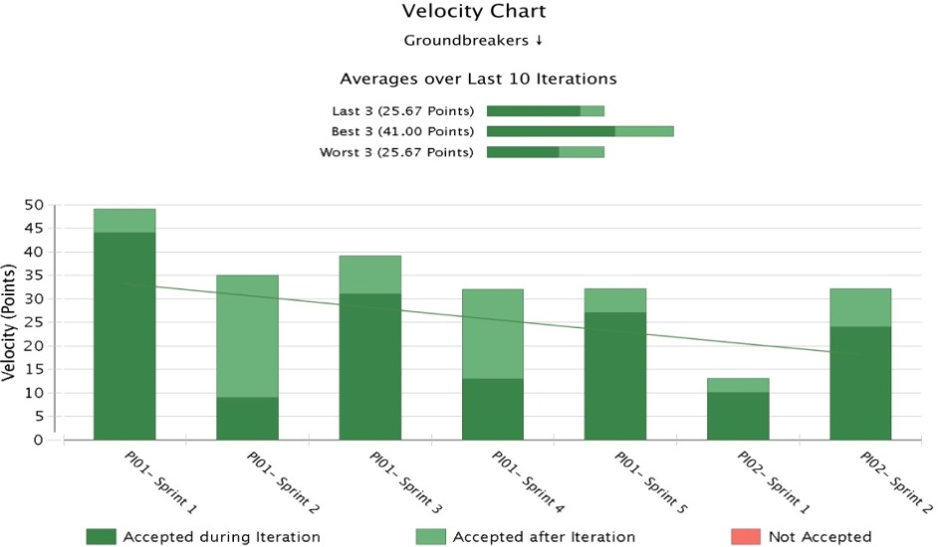
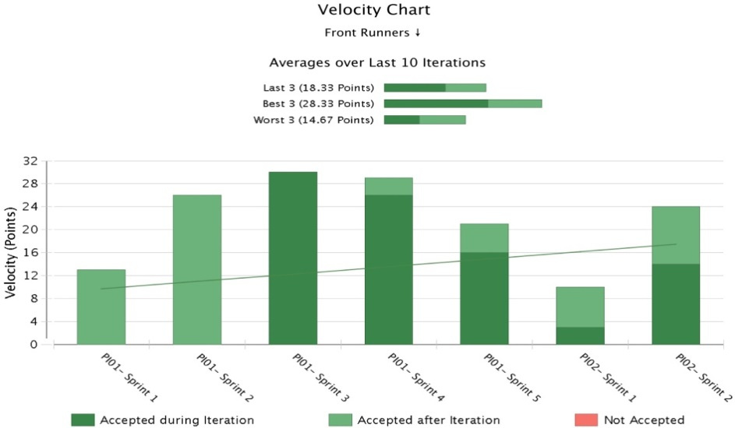
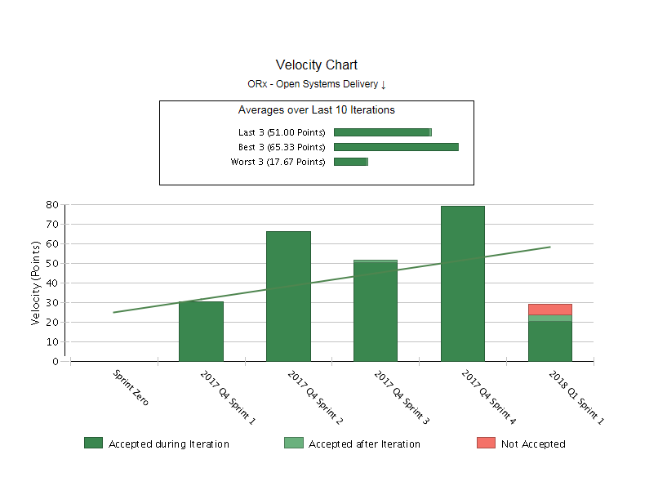
Velocity Charts for Agile Transformed Teams
Groundbreaker
Front Runners
The vertical axis indicates Velocity view for the 5 sprints delivered with total of 60 SP.
Maximum of 79 SP delivered in sprint4
Total of 254 Story points completed by team
Optumizers
Velocity View
Notes:
Can we increase the font size of graphs contents – not readable
Also can we have key pointers / call out

Slide 14
Support Project Metrics
Notes:
We need some commentary and key call outs
Also for RxClaim – overall availability is up despite of outage in Sep 2017 – it is correct (what is source of information)

Slide 15
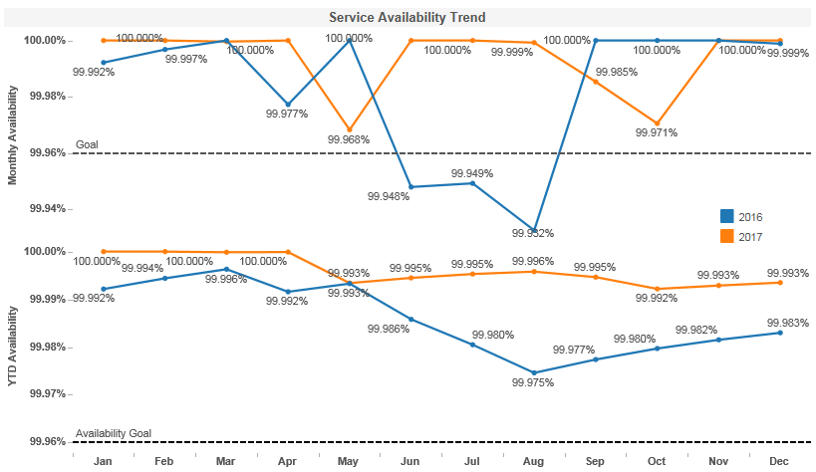
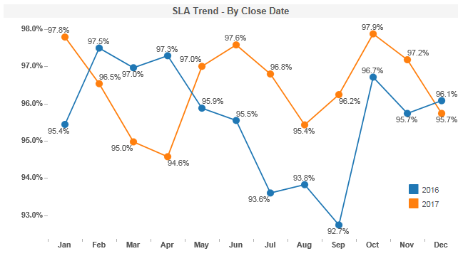
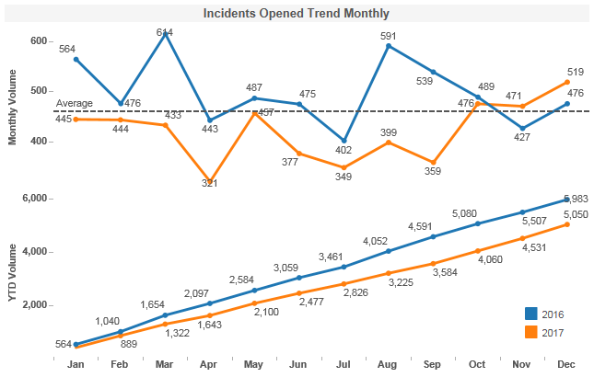
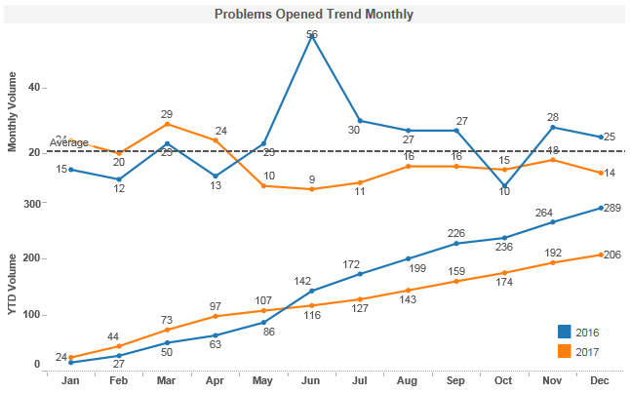
RxClaim Application Metrics
Overall availability increased as proactive monitors were implemented for potential causes.
SLA were improved as guidelines were in place and with regular tracking
Overall influx reduced as most of the recurring issues were permanently addressed.
PT influx reduced as Leaked defects excluded and recurring issues were already addressed.

Slide 16
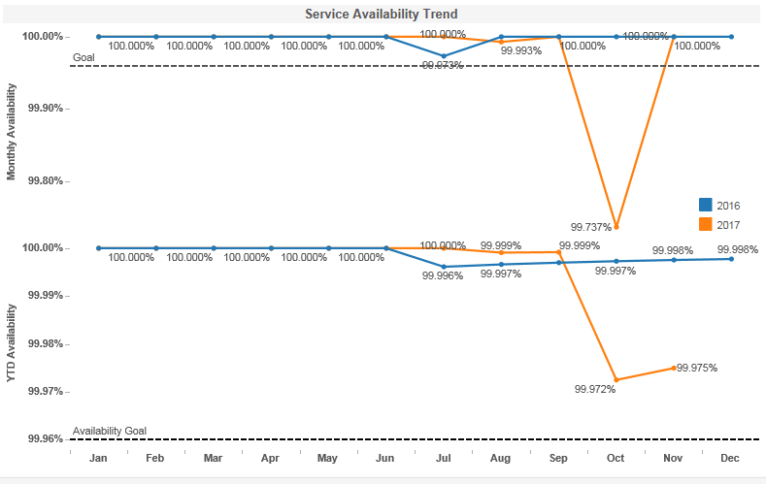
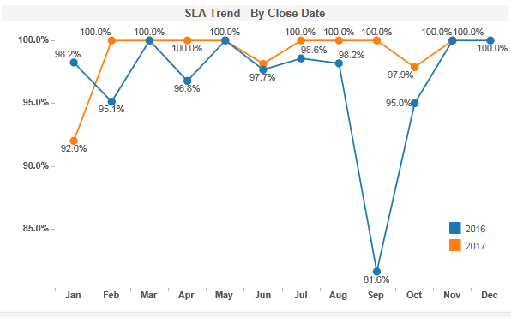
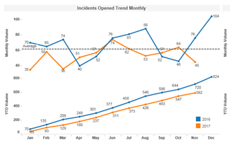
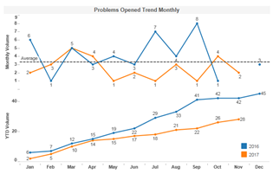
RxWeb Application Metrics
Availability impacted majorly due to Navigator change where they removed IP for RxWeb services.
SLA were improved as guidelines were in place and with regular tracking
Overall influx reduced as most of recurring issues were addressed proactively.
Problem influx reduced as recurring issues were already addressed.

Slide 17
Initiatives

Slide 18

Rx Claim – Dev Continuous Improvement - 2017
Achieved
$ 5.18 MM
Target : $4.27 MM
27 Ideas Implemented
SSMO - $4.7 MM
Govt Pgm– 0.27 MM
DELI – 0.1 MM
Retrofit - $0.8 MM
24% Lean Trained
7% Lean Certified
Challenge
Solution
Impact
Standard automated process established to Monitor all user libraries in Production, Notify Users and purge unwanted data
Manual effort saved 100 hours / month
Storage saved 12 TB / month
Business Impact of $3 MM
Manual monitoring of DASD utilization, Data deletion operations, Notifying users
Space Issue in IFS Folder
Lack of Purge Process
Developed a purge process which can be used to purge files at IFS location using File Naming Convention and Retention.
Reusable Purge Process
Business Impact of $0.4 7MM
Manual Process for generating reports through SAS Jobs for M&R, Core and External Customers
Created a utility to increase the performance and configured it for the 4 critical jobs
Automated Reports for Business to analyze
Business Impact of $0.36 MM
Spool files occupying space with no aging process with potential impact to system performance
Automated process to delete Spool Files in Daily production basis aging
Avoid impact on System Performance
Business Impact of $0.28 MM
Dual simultaneous development leading to defects and production issues
Creates a job which select those objects in CLMV25OBJ which has Todays create date and check if these objects are currently checked out in Base release. If yes, then auto mail to developers
Reusable Dual Development Comparison Tool
Business Impact of $0.24 MM
Manual process for creating the 835 File with no purge process and tracking mechanism of issues
Created a Auto purge process for the files for empty members in defined libraries at defined intervals with an input file to store the details of the files, libraries , record threshold for purge
Avoid impact on System Performance
Business Impact of $0.13 MM

Slide 19



CI 2018 Road Map – Rx Claim Dev
Execution, Simplification & Cost Management
Reduce P1 & P2 Incidents
Improve Pre / Prod Defect Density
Innovation / Cost Saving
$ 5.5 MM Business Impact
Implement Ideation Council towards Innovation
2018
Focus Areas
Culture & People Engagement
Improve Bright Idea penetration and Implementation
Improve Lean and GB certification
Business Integration and Alignment
Rx Manual Claim Automation
BOM Opportunities – Client onboarding TAT etc.
Confidential property of Optum. Do not distribute or reproduce without express permission from Optum.

Slide 20
Our People First

Slide 21
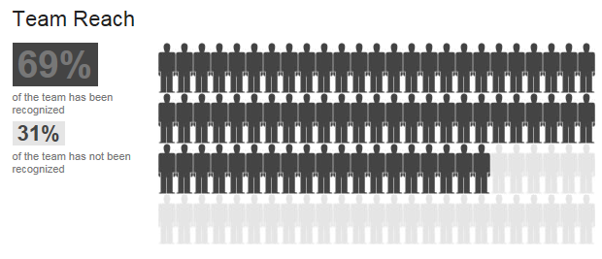
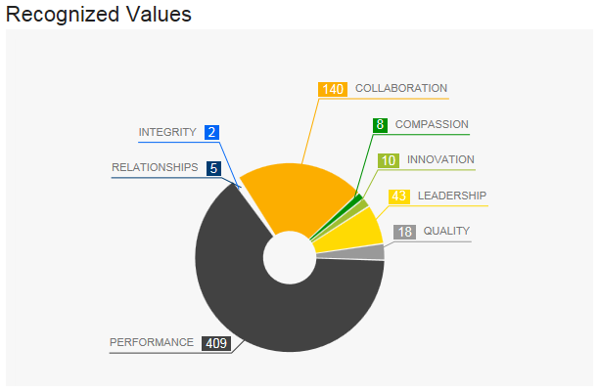
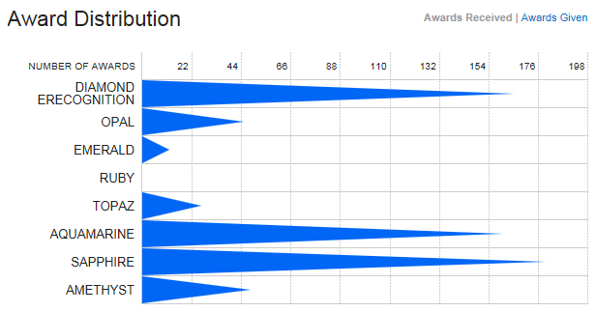
Bravo
298 Recognitions from onshore stakeholders
185 in Q4 (75% of total Bravos in Q4)

Slide 22
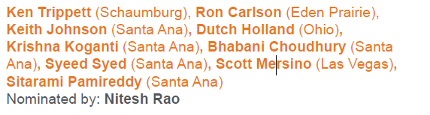
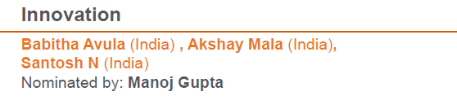
IT Rock Stars
Team Work

Slide 23
2018 Focus Areas

Slide 24
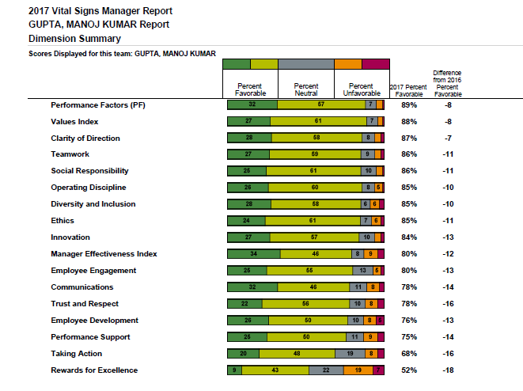
Vital Sign 2017
Scores have gone down as compare to last year:
Lot of new team members (neutral score have gone up)
Org changes in the middle of the year e.g. SSMO

Slide 25
Focus Areas – Strategic / Operational
Strategic
Operational
Improve development quality; shift from Quality Assurance to Engineering & Test Automation – Defect Prevention vs. detection.
Adaption of Agile delivery methodology along with CI/CD / DevOps implementation
Implementation of Hybrid CoE (End to End Delivery) framework
Improve Penetration in Formulary (Vendor Transition)
Consolidation of eligibility – unique member id across multiple instances of RxClaim
Optimize RxClaim sources achieving a 10% productivity target (cpu, disk, pgms).
Standardize model, instrumentation and support practices across all platforms – Production Support for LCTR instances
IT-BPO Collaboration (specific pointers e.g. BOM) to improve / automate client onboarding process
Design and Implement a Global rotation policy for developing SME’s on Core applications

Slide 26
Appendix

Slide 27
Monthly Releases Metrics

Slide 28
Monthly Releases Metrics (Cont…)

Slide 29
Delivery update by teams

Slide 30
Plan Team Updates
Engagement Update for 2017
Engagement Updates
IBM - OGS transition completed successfully during 8305 release .
During last three releases (8306, 8307 and 8308) we have delivered 83 SRs and spent almost 21K hours in total
Key Achievements and Enhancements
Improved Capabilities in areas like Batch Loads/Extracts, DBIs, Compounds, High impact Database changes, Major screen changes, Utilities like Plan Maintenance/Audit and Conversions
Enhancements were done for the identified areas in the RxClaim compound functionality in order to allow the client to be compliant and increase safety measures of compound prescriptions
EGWP Phase 1: Introduced new set of EGWP rules to support complex benefits for members at POS in addition to enhancement to the pricing logic for Medicare plans
Enhancements to NCPDP load programs to support additional data related to Pharmacy for government program compliance
Major updates to Prior Authorization to include Overrides for Prescriber/Provider & Diagnosis, COB & Seq. Age Thresh w/ QL
Enhanced Transitional Benefits logic to optionally pay drugs only up to a certain quantity as defined by the plan by introducing Daily Dose restrictions
Enhancement was done to move the copay- only lists to Preferred Formulary edit. MSC and OTC indicators were added to Preferred Formulary Edit.
Major Functional Area Covered
Prior Authorization, Compound Processing, Transition Benefits, DBIs, PLAN NDC/GPI Lists and DEA

Slide 31
Plan Team Updates (Cont…)
Engagement Update for 2017
Challenges Faced
Concern over quality of deliverable in 8307 release
Process Improvement / Other Initiatives
Lessons Learnt Documentation for every release
Maintaining Review logs for each phase of development and taking actions based on the most common errors identified
Documentation of key functional enhancements after every release and shared with broader group
Mentorship in Batch projects - Mentored 2 resources from CEBU team and 1 offshore
Software Development Reviews introduced for SRs with medium to high risk
ADR as a one stop repository for all release documents and approvals
Key Action Items for 2018
Prepare the team for Agile journey
Build SME Capabilities in the team within identified functional areas
Deep Knowledge sharing sessions across various RxClaim applications
Delivery with highest quality

Slide 32
Modernization Team Updates
Engagement Update for 2017
Engagement Updates
GalaxE - OGS transition completed successfully during 8306 release
During last three releases (8306, 8307 and 8308) we have delivered 53 SRs and spent almost 6K hours in total.
Key Achievements and Enhancements
Modernization Team has been continuously working in improving the system performance by using SQL Views/ Indexes and also by implementing Embedded SQL wherever required
Conversion process is one such area lead by Modernization Team and used across by Dev/ QA Teams, that has been enhanced in every release to ease its usage
Challenges Faced
While working independently in 8307 release, we feel that there was knowledge gap from Galaxe Solutions during the KT sessions but we were able to fill these gaps with regular interaction with Onsite.
Process Improvement/ Other Initiatives
Data setup during Conversion process is pretty time consuming and also results in errors from Dev end. Efforts are being made/ in-progress to completely automate data setup for this utility. This would save a lot of time for the Developer/ QA and would also result in fewer issues/ errors.
Internal Team Meetings to make sure every team member is on the same page
Maintaining all the QMS documents to improve Health Assessment Score in each release
Identified SME’s amongst the team in different functional/ technical areas.
Key Action Items for 2018
Continue to identify SME’s amongst the team members for different areas.
Spend more time in creating/ implementing wide variety of test cases to make sure no Defect occurs later on in Production.
Improve Dev estimates to make sure they are in synch with BGE estimates.

Slide 33
Govt Programs Updates
Engagement Update for 2017
Engagement Updates
IBM - OGS transition completed successfully during 8305 release .
During last three releases (8306, 8307 and 8308) we have delivered 64 SRs and spent almost 17K hours in total for the Core Govt Programs release.
Custom Capital projects have been delivered on monthly releases scheduled and spent almost 21 K hours in total for the custom capital projects for year 2017.
Key Achievements and Enhancements
Built SME expertise in areas like Batch Loads/Extracts, PDE, Plan Finder, EOB, Reprocessing functional areas
Team is able to support successfully for the critical RxParallel impact support and critical reliability case support for the Govt programs projects.
Enhancements were done for all the primary areas of Govt programs like PDE, Plan Finder, Reprocessing and EOB.
CalPERS Projects: To execute payments and remittance advices to members and pharmacies in support of the implementation of CalPERS. There are custom files and reports that require development using file layouts supplied by both entities.
Cigna Projects: Updated the PA reporting/loading processes to extract/load the PAs multiple times during a day as needed by the Clients. Allow clients to load/extract additional data to the Pharmacy Cost Pricing Schedule using which the Plan finder files are generated.
Other major Projects: Texas ERS Surcharge Reporting Project: To enhance RxClaim to calculate surcharge values based on client rules, record and report the same for payment and billing. SN002207: Allow 2-carrier wrap plans, that are not EGWP plans, to be administered as a single carrier plan. Updated packed and unpacked Part D extracts. SN002556: Phase-2 of SN002207, record any adjustments on the claim. Updated the packed and unpacked ADE extracts.
Built SME expertise for Custom Capital functional areas like Billing & Payments, RTA, Day 1 process and CHF.
Govt Programs Custom Capital team handled critical Nebraska Rebid Phase 1 and Phase 2, ORCA CLI1 - Phase 1, ORCA COR2 Include Duplicate for Internal Clients, COR2-CLM &EX7 Transfer projects.
Major Functional Area Covered
PDE, EOB, Plan Finder, Reprocessing, Part D Extracts & Loads, Custom Payments & Billing

Slide 34
Govt Programs Updates (Cont…)
Engagement Update for 2017
Challenges Faced
Resource shortage for 8308 and 8400 releases.
Process Improvement / Other Initiatives
SDR Reviews are initiated from 8308 release for all the Govt Program projects
Lessons Learnt Documentation for every release
Maintaining Review logs for each phase of development and taking actions based on the most common errors identified
Documentation of key functional enhancements after every release and shared with broader group
ADR as a one stop repository for all release documents and approvals from 8400 release onwards
Key Action Items for 2018
Prepare the team for Agile journey
Build SME Capabilities in the team within identified functional areas
Deep Knowledge sharing sessions across various RxClaim applications
Delivery with good quality
Initiative Updates
Avoid Dual Dev Code drop issue - Multiple instances have been observed where the business functional changes developed / enhanced during dual development are overwritten by base development changes because of missing communication among the developers. Developed a tool to notify developers with an email to take the latest version of the source as the object has been modified during dual development. This will avoid Loss of business functional change because of code overwrite.
Capacity Tracker Tool – All the RxClaim Managers and Leads are spending lot of time to adjust capacity on every week because of the huge volume of work. A tool has been created to calculate available capacity for the project for every week. This will be helpful to know the each team capacity and saves lot of time for Managers and Leads.

Slide 35
Deli (WO Base + State Medicaid) Team Updates
Engagement Update for 2017
Engagement Updates
IBM - OGS transition completed successfully during 8305 release .
During last three releases (8305, 8306, 8307 and 8308) we have delivered 106 SRs and spent almost 5K hours in total
Key Achievements and Enhancements
State Medicaid team is the first team in RxClaim to adapt Agile methodology development. A journey of successful implementation of 4 sprints covering 253 user points without any business defects in production proved the sustaining adaptability of the team
Successful on boarding of new clients into State Medicaid to improve the member coverage by expanding to 4000+ membership thru “GOLD COAST” for California client
Successfully submitted Utah encounter Test file with state. Acceptance ratio of claim is ~98.7%. This is the highest acceptance ratio of claims achieved in 1st attempt.
Successful implementation of one of the big 3 clients “CalPERS” into RxClaim
On boarded 160+ new clients to CHF functionality in LCTRx and generating report on daily/ weekly/ monthly intervals
Improved member satisfaction by identifying the bypassing claim records and reprocessing them accordingly and saved a potential penalties of $60k per year going forward
Performance tuning of CalPERS claim extract to run from 8 days to 5 hours is a big improvement and business is very happy as they are getting the reports on timely basis
Successful implementation of new enhancements for CA, AZ, IL state Medicaid and mitigated the potential penalties of $120k
Successful implementation of a lean project to improve the reject variance from State Medicaid encounter reports and saved around $72K.
Major Functional Area Covered
Accumulators, Eligibility, Loads and Extracts, Payment reports, EOB, CHF and Mac list generation

Slide 36
Deli (WO Base + State Medicaid) Team Updates (Cont…)
Engagement Update for 2017
Challenges Faced/ Risks/ Mitigations
Concern over quality of deliverables in 8304 release
Projects struck in UAT phase for long time and delaying in the project implementations and impacting new project schedules
Last minute changes to the SRs, impacting the project schedules and quality of the deliverables
Code sync issues in different releases causing override of new functionalities introduced in previous releases
Multiple release checkout issues, causing overwrite of enhancements to the functionalities
File change impact analysis missing new objects introduced in retrofit release causing level check errors in production.
High possibility that two developers have to work on a single program for different user stories – increasing the turn around time for the whole deliverable.
Process Improvement / Other Initiatives
Improved/ increase scope of WO team – Initiated the SA training and internal trainings to improve the resource competencies.
Maintaining Review logs for each phase of development and taking actions based on the most common errors identified
Software Development Reviews introduced for SRs with medium to high risk
Movement to ADR as a one stop repository for all release documents and approvals
Key Action Items for 2018
Prepare the WO team for Agile journey in Q1
Build SME Capabilities in the team within identified functional areas
Deep Knowledge sharing sessions across various RxClaim applications
Delivery with highest quality

Slide 37
State Medicaid
Team 1: Groundbreakers
 | Start | End | Planned Stories | Accepted Stories | Delivered Story Points
PI01-Sprint 1 | 9-Oct-17 | 25-Oct-17 | 10 | 10 | 49
PI01-Sprint 2 | 25-Oct-17 | 8-Nov-17 | 11 | 11 | 35
PI01-Sprint 3 | 8-Nov-17 | 21-Nov-17 | 9 | 9 | 39
PI01-Sprint 4 | 22-Nov-17 | 5-Dec-17 | 10 | 10 | 32
PI01-Sprint 5 | 6-Dec-17 | 19-Dec-17 | 9 | 9 | 32
PI02-Sprint 1 | 20-Dec-17 | 2-Jan-18 | 5 | 5 | 13
PI02-Sprint 2 | 3-Jan-18 | 16-Jan-18 | 9 | In Progress | In Progress
 |  | Total | 63 | 54 | 200
Team 2: Front Runners
 | Start | End | Planned Stories | Accepted Stories | Delivered Story Points
PI01-Sprint 1 | 11-Oct-17 | 25-Oct-17 | 2 | 2 | 13
PI01-Sprint 2 | 25-Oct-17 | 8-Nov-17 | 7 | 7 | 26
PI01-Sprint 3 | 8-Nov-17 | 21-Nov-17 | 8 | 8 | 30
PI01-Sprint 4 | 22-Nov-17 | 5-Dec-17 | 8 | 8 | 29
PI01-Sprint 5 | 6-Dec-17 | 19-Dec-17 | 7 | 7 | 21
PI02-Sprint 1 | 20-Dec-17 | 2-Jan-18 | 3 | 3 | 10
PI02-Sprint 2 | 3-Jan-18 | 16-Jan-18 | 8 | In Progress | In Progress
 |  | Total | 43 | 35 | 129
Major Functional Impact
Till date, a total of 89 user stories of worth 329 Story points delivered successfully without any issues on combination of both the teams
Currently, 2018-PI02 Sprint 2 is in progress and to complete on 16-Jan
As part of Product Increment1 (2017-PI01) , deployed following with no issues
VA – 5 corresponding SRs deployed to Production
HNJ – 3 corresponding SRs deployed to Production
OR - 2 corresponding SRs deployed
Accomplishments | Risks /Challenges/ Issues
Successfully submitted Utah encounter Test file with state. Acceptance ratio of claim is ~98.7%. Virginia Encounter implemented successfully in a short time and received a positive acknowledgment from state. Successful completion of 6 sprints without any issues in production. Smooth journey over Agile methodology being the first team from RxClaim. | Pair Programming: Dependency ,Merging and sometimes Rework in case of multiple members working on same program or SR Collaboration : maintaining a separate copy for each and merging the changes once done and then continuing Unit Testing Support: One member develops code and other helps in supporting activities such as Test data preparation and executing Unit Test cases.

Slide 38
Custom Data Deli – Major Accomplishments and Functions
Volumes delivered till Nov 2017
PRJ | WO - Configurations | WO- Code changes
26 | 102 | 28
Major Functional Impact
POLARIS program
Initiated in 2016 this program involved migration of groups and members from OXFORD to CIRRUS platform in a phased manner (expecting more members migrate to CIRRUS as per current trend)
Deli Team involved in modifications of Eligibility and Claim History files and deployed in BK2 on 12/1
TEXAS ERS
One of the BIG 3 clients implemented in 2016.
Received request to move the membership from Book2 to Book1 and also involved for complex WTX map, ID card extract and Claim History file related changes.
Implemented above requests n August
WTX
Implemented new maps for Hartford, Morgan Stanley and Federal reserve bank with aggressive timelines
NICE
Project to add new accounts to the existing eligibility load on Book1
The implementation is due for 1/1
Pharmacy COUPON Phase-2
This project is to correct the Member’s deductible and Out of Pocket expense when coupons are applied on the claim
CVS 90 & Preferred 90
CVS90 and the Preferred 90 programs will have very similar functionality to the existing Mail Service programs: Mail Service Saver and Mail Service Saver Plus. A key difference is the added capability to get a 90-day fill either at a CVS store or Walgreens store, respectively, or ORx Home Delivery via mail.

Slide 39
Custom Data Deli – Initiatives, Challenges, Lessons learnt
Initiatives
CFT Utility process enhancement (Bright Idea #81041)
We have made enhancement to existing CFT utility process to support all file type extensions
Earlier it was supporting only Upper case file extensions
After change we can use these utility for all file type extensions (Lower and upper cases)
Challenges
To eliminate repeated efforts in QA/UAT
In past we were repeatedly getting requests from QA/UUT teams for running few processes.
We have identified such processes from our daily routines and shared the info with them.
Sharing few critical processes steps with QA team made our QA/UAT execution streamlined.
Lessons Learnt
While executing jobs in lower environment we need to ensure the file is not sent to prod servers and doesn’t triggering jobs at down streams
When jobs are migrated from one LPAR to another, we need to make sure that the dependent objects are present in target LPAR.
We use TWS for job migrations and TWS back end teams missed to update dependency. Developer need to cross check for any discrepancy.

Slide 40
External interfaces – Major Accomplishments and Functions
Volumes delivered till Nov 2017
PROJECTS
28
Major Functional Impact
MOOP-PA Load
Business introduced New/Separate group list (Preferred Diabetic Group List) as a separate function and its maintenance .This required the enhancement in Prior Authorization load file creation at L-ORx side for two major processes (COSMOS and CSP), which was earlier built to support Standard MOOP Group List. CMS is the entity that identified that we were not charging patients correctly and indicated it must be corrected ASAP. If it comes up in an audit again with CMS we could be sanctioned, meaning no new members for at least 6 months and some very large penalty fees. (A conservative estimate is $1 Million….but it could be higher, depending on how many plans/states CMS could potentially sanction). With successful implementation of this project … 1) L-ORx will be able to add/maintain a new Preferred Diabetic Group List. 2) This will create the correct PA information for Business and will reduce extensive manual work. 3) Monthly Extract will help them to track those member who have moved from Standard MOOP Group List to Preferred Diabetic Group List and vice versa
CIRRUS-POLARIS- Accumulators
Polaris is a a new client, Optum RX & Polaris’s Cirrus Medical application will be exchanging all shared (Medical & Pharmacy) accumulator data thru Claims highway to sharing accumulators by applying Deductible and Out Of Pocket.
CAMS BCD Travel industries Group
Currently CAMS connects only with Book2 via B2B MQ. This project exists to route CAMS inbound transactions to BOOK1 and support building and maintaining multiple solutions for accumulator exchange files for CAMS to support the OptumRx carve-out client arrangements

Slide 41
External Interface – Initiatives, Challenges, Lessons learnt
Challenges
In L-CTRx for PAS testing RxClaim Services are not working consistently. PAS is receiving Connectivity errors frequently. Due to which PAS Unit Testing, QA Testing and Debugging of QA issues are on Risk. We need a process where RxClaim dev team should be notified before the services are down from MQ team.
Lessons Learnt
Most of the defects are non-value added and to avoid such defects we have started a process where QA and Dev team can have a weekly call on defect status and also before logging any defect QA team should confirm with respective Dev team first.

Slide 42
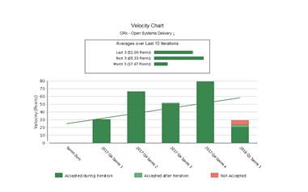
RxSupport Redesigning (Optumizers)
Sprint Details
SP delivered in last 5 Sprints
Team Optumizers
 | Start | End | Planned Stories | Accepted Stories | Delivered Story Points
Sprint 1 | 6-Nov-17 | 18-Nov-17 | 9 | 9 | 30
Sprint 2 | 20-Nov-17 | 2-Dec-17 | 15 | 15 | 66
Sprint 3 | 4-Dec-17 | 16-Dec-17 | 13 | 13 | 51
Sprint 4 | 18-Dec-17 | 29-Dec-17 | 14 | 14 | 79
Sprint 5 | 02-Jan-18 | 13-Jan-18 | 9 | 8 | 28
 |  | Total | 60 | 59 | 254
Major Functional Impact
Total of 5 Sprints delivered with 60 user stories. 254 Story points completed successfully without any issues on combination of both the teams
Sprint 6 is in progress .
In Sprint 1 team was working on virtual desktop , but later on with team effort and knowledge we were able to move to local network which in turn result in delivery of more user stories and story points
Accomplishments | Risks /Challenges/ Issues
Successful completion of 5 sprints without any issues in UAT Recognition from client for delivering using Agile and faster response time | Gaps between onshore and offshore regarding understanding of Agile methodology

Slide 43
CBS Updates
Engagement Update for 2017
CBS COR2 Project
Migrating Internal OptumRx Clients from current L-Orx system to CBS billing system and supporting the current billing and reporting requirements
CBS server upgrade : In-progress
Data stage server upgrade version 8.7 to 11.5
WebSphere application server upgrade version 6 .1 to 9.0
Enhancements projects : In-progress
Carrier Hierarchy Screen Enhancement - The existing Carrier Hierarchy screen in the CBS application are insufficient for business users to view and validate the necessary information. Enhanced the functionality to give more details for Validating CAG information.
Proc Claim Daily Performance Improvement - In order to improve the performance of Proc Claim daily job, it is required to limit the scan of Claim Header table to last 60 days only.
LSTAT Changes to drop and reload data for 7 days only - LSTAT table which contains the statistics about claims loaded in ODS and BNP currently holds data since its existence (2015). The job logic modified to truncate and load the table and hold only 7days of historic data from the current system date.
Add source sys id on the Client Info Screen – Business user is able to filter out carriers based on the source system id.
FTP Failures - search for Missing Folders - When the FTP process delivers a file to the shared drive location, it searches for a specific folder. Sometimes, when a folder is moved from the shared location, the FTP process cannot complete successfully, which can result in the job failure. The FTP process will be modified to auto-create a new folder and drop the file when a specific folder is not found in the shared location.
Archiving Claims data - Performance Improvement by the table partitioned stores claim data.
Traceability of all jobs from the Job Controller Dashboard
Automation for e-mail notifications.

Slide 44
MODS, Retrofit and Kaiser Updates
Engagement Update for 2017
MODS – key Engagements and Achievements
Complete development is happening at OGS.
Delivered MODS 8.3.4, 8.3.5, 8.3.6, 8.3.7 and 8.3.8 with out any major/critical production issues.
All the ported code from RxDev to SXCD1 is being maintained by MODS team only.
MODS team has successfully implemented RxBuilder and RxParallel at BK1/BK2 environments.
Retrofit – Key Engagements and Achievements
OGS Retrofit team started in mid of April and took transition from Galaxe team.
Delivered 49 SRs to Production with zero Production defects.
Initially only Government Program and PLAN Retrofits were handled, from August Work Order and Med Encounter Forward fits were also added to Retrofit queue and all of them were deployed with quality.
Kaiser – Key Engagements and Achievements
Kaiser team was formed in the mid of August and took transition from Galaxe team.
Delivered 5 8308 SRs which zero value added QA/UAT and Production defects.
Even though the team is new to RxClaim functionality gained expertise in Kaiser Extract process and EOB functionality.
Challenges/ Risk / Mitigation:
Entire Team is new to RxClaim functionality – We are building RxClaim expertise through Knowledge Sharing Sessions.
Base Development projects should consistently assign their corresponding retrofit SRs development tasks so that Retrofit Team can plan its capacity accordingly.

Slide 45
MODS, Retrofit and Kaiser Initiatives
Initiative Update for 2017
Lower environment cleanup – Many times objects related to unofficial patches or objects related pulled our SR’s are being left out as orphans in lower environments. As such objects are never cleaned up, lower environments were kept out of sync with production systems and impacting QA/UAT testing. So MODS team created a tool to identify all such objects and clean the lower environments to keep the lower environments in sync with production. This is a regular activity for every MOD release.
Object Comparison Tool - Objects are prone to miss to check out in Retrofit SRs and these objects are manually verified with Base SR objects. This manual verification is prone to human errors when the objects list is huge. This can be automated through an Object Comparison Tool and we can mitigate these human errors. A new tool has been developed which compares Base SR and Retrofit SR objects. We input the Base SR and Retrofit SR Number. It lists out the all the objects of Base and Retrofit SR and also lists the mismatched objects on Screen.
SR Document Tracker Tool - SR artifacts/ Documents are located in respective I drive and J Drive folders. To find these documents we have to search manually in respective I and J drive folders. This will consume more time to search documents as I and J drives contains huge amount of data. So this Search process can be automated through SR Document Tracker and we can reduce the time of search. To make the access to these artifacts in a simple way with a single click, a new tool has been developed. By giving the SN/SR Number as input we can access all the documents in a single screen. We can also Audit if any of the corresponding documents were present or missing and we can edit/create/display them from this tool.

Slide 46
Retrofit and Kaiser Updates
Engagement Update for 2017
Retrofit – Key Engagements and Achievements
OGS Retrofit team started in mid of April and took transition from Galaxe team.
Delivered 49 SRs to Production with zero Production defects.
Initially only Government Program and PLAN Retrofits were handled, from August Work Order and Med Encounter Forward fits were also added to Retrofit queue and all of them were deployed with quality.
Kaiser – Key Engagements and Achievements
Kaiser team was formed in the mid of August and took transition from Galaxe team.
Delivered 5 8308 SRs which zero value added QA/UAT and Production defects.
Even though the team is new to RxClaim functionality gained expertise in Kaiser Extract process and EOB functionality.
Challenges/ Risk / Mitigation:
Entire Team is new to RxClaim functionality – We are building RxClaim expertise through Knowledge Sharing Sessions.
Base Development projects should consistently assign their corresponding retrofit SRs development tasks so that Retrofit Team can plan its capacity accordingly.

Slide 47
Retrofit and Kaiser Initiatives
Initiative Update for 2017
Object Comparison Tool - Objects are prone to miss to check out in Retrofit SRs and these objects are manually verified with Base SR objects. This manual verification is prone to human errors when the objects list is huge. This can be automated through an Object Comparison Tool and we can mitigate these human errors. A new tool has been developed which compares Base SR and Retrofit SR objects. We input the Base SR and Retrofit SR Number. It lists out the all the objects of Base and Retrofit SR and also lists the mismatched objects on Screen.
SR Document Tracker Tool - SR artifacts/ Documents are located in respective I drive and J Drive folders. To find these documents we have to search manually in respective I and J drive folders. This will consume more time to search documents as I and J drives contains huge amount of data. So this Search process can be automated through SR Document Tracker and we can reduce the time of search. To make the access to these artifacts in a simple way with a single click, a new tool has been developed. By giving the SN/SR Number as input we can access all the documents in a single screen. We can also Audit if any of the corresponding documents were present or missing and we can edit/create/display them from this tool.

Slide 48
RxClaim & EDI – SSMO
Engagement Update
Major Accomplishments:
Identified root cause for Price Load issues:
Several issues with price loads in Book2 causing incorrect payments from members and it led to high level escalations.
Support team involved business and IT teams & performed several working sessions to find the root cause of the issue.
Root cause of the issue is identified as the format of the data being sent from source system (ACIS) which is incorrectly updating pricing information for 2018 timelines.
Helped the source team in understanding the issue and format/process to be followed in future to avoid similar issues.
RCR Issues with missing configurations:
- Business opened a high priority incident to identify the root cause of missing claims in reject claim audit reports.
- Team worked with business and IT teams to confirm the root cause of the issues are due to missing configuration entries for 2018 and it impacted reject claim reporting audit.
Resolved more than 120+ tickets every week starting from last week of December without impacting SLA’s.
Resolved several issues with interfacing applications related to member details, trail claims, prior Auth related.
Active participation in command center proactive health check WebEx & group chats every from 6.30 PM till 11.30 PM
Continuous monitoring of all critical application areas to address the issues at early stages before it causes a war room.
Avoided War rooms with proactive bounce of RxMacro Servers:
- Support team proactively recycled RxMacro application server as there was spike in CPU usage to avoid P2 impact to business as business will be using Macros extensively during 1/1.
C2Medication PMP reports
RxEDI application receives 120 PMP reports on daily basis, due to the high count of files while processing into the application lot of manual efforts are involved in it for both business & IT teams & load takes 8 hours to complete.
We have automated this process to load these reports with in 2 hours and saved manual efforts for both IT and business teams.

Slide 49
RxWeb – SSMO
Engagement Update
Major Accomplishments:
PAS Commercial formulary lookup application facing latency issue
PAS Commercial formulary lookup application facing latency issue when they search the formulary information by DrugID.
Optimized the PAS formulary search process to pull only one drug details by DrugID instead of pulling whole list of drugs for the formulary plan.
CT Logic Enhancement:
FACT and Content Manager are the current platforms that support the maintenance of Book 1 Part D formularies. These applications identify formulary defects via a daily validation process It also provides daily automated tier/exclusion updates to RxClaim thus reducing misalignment with CMS submitted formularies.
It is critical for the business to ensure that the processes are optimized and that reports are run daily per CMS guidelines.
This implementation would minimize member disruption and helps business.
Brand over Generic on FACT Crosstab:
- FACT application sends Drug information reports to Business on daily basis for validation purpose. Business needs to manually validate the report and manipulates the drug data to determine if it is a brand or generic and include this information in the required reports.
- Added a new process to FACT application which automatically identify, if a drug is branded or generic and sends the reports to business on daily basis which avoided manual interpretation and assured report accuracy.

